Slide 1
Maternal Hypertension Initiative
April Action Period Call - Readiness
May 28, 2021

Slide 2
Welcome!
Please type your name and institution you represent in the chat box and send to “Everyone”.
Please also do for all those in the room with you viewing the webinar.
Thank You

Slide 3
Welcome!
Attendees are automatically muted to reduce background noise.
You may enter questions/comments in the “chat” box during the presentation. We will have Q&A session at the end.
Slides will be available via email and at www.alpqc.org
We are now recording

Slide 4
Agenda
Maternal HTN Updates
12:05 – 12:10
Baseline Survey Results
12:10 – 12:20
Readiness Driver: Standard order sets, protocols, checklists, triage
12:20 – 12:50
Q & A
12:50 – 1:00
Next Steps
1:00

Slide 5
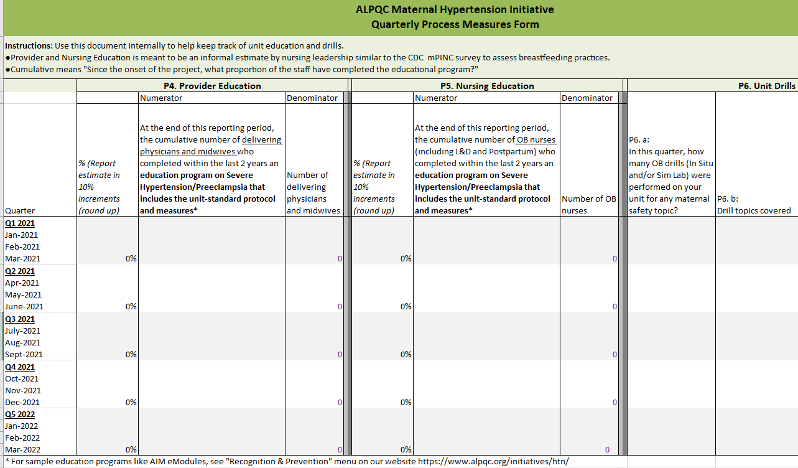
Maternal HTN Updates
Quarterly process measures – simplified
Measure Type | Measure | Reporting Frequency
Process | P4. Provider education - % who completed education | Quarterly Due a month after quarter ends Jan-March 2021 quarter due April 30
 | P5. Nursing education - % who completed education | Once per initiative
 | P6. Unit drills - # of OB drills, topics
Find data forms on our website at www.alpqc.org/initiatives/htn/, under the “Data Resources” menu​​

Slide 6
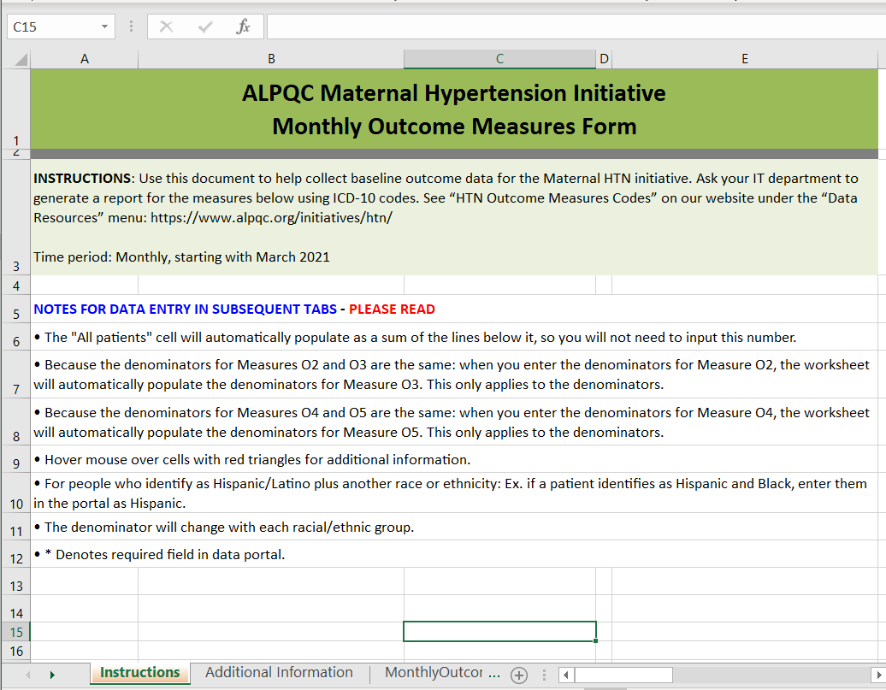
Maternal HTN Updates
New monthly outcome measures data collection form
Find data forms on our website at www.alpqc.org/initiatives/htn/, under the “Data Resources” menu​​

Slide 7
Maternal Hypertension Baseline Survey Results

Slide 8
Live Births
Average
= 1790

Slide 9
NICU Level

Slide 10
Maternal Care Level

Slide 11
Does your unit have standardized processes (e.g., order sets, unit policies, practice protocols) for obstetric emergencies?

Slide 12
Does your facility's ED have standardized processes (e.g. order sets, unit policies, practice protocols) for obstetric emergencies?

Slide 13
Do you conduct drills on a regular basis on the unit?

Slide 14
Drills Conducted
What was the topic of the last drill performed on the unit?
Maternal and neonatal code (1)
Severe newly-onset hypertension (3)
Shoulder dystocia (2)
Obstetric hemorrhage (2)
Do you typically debrief following drills on the unit?
Yes (8/8)

Slide 15
Do patients receive educational materials on urgent signs
and symptoms to report…..
…while they’re in the hospital?
…after they are discharged?

Slide 16
Past QI Successes / Challenges
Please describe your unit's challenges in implementing past QI projects
Difficulty with staff “buy-in” to the new practices, new protocols and order sets based on evidence-based practices and ACOG recommendations
Turnover of nursing staff and re-education
Physician pushback with QBL
Issues with IT implementing QBL calculator
Large number of staff makes it hard to get everyone on board with initiatives and changes
Please describe your unit's successes in implementing past QI projects.
We have had success in implementing most of the changes made
Great success with physician buy-in, education for staff, and implementation
Nurses adapted well to initiatives.

Slide 17
Maternal Hypertension Readiness Driver

Slide 19
Nichole Shockley, RNC-OB, BSN
Charge Nurse of Operations
Labor & Delivery
Huntsville Hospital for Women & Children

Slide 20
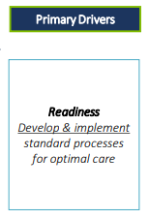
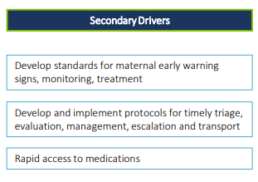
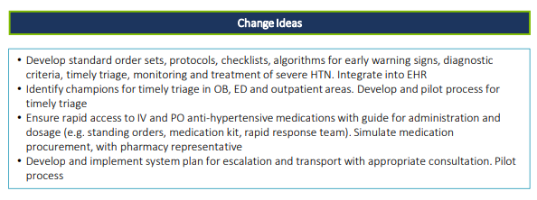

Slide 21
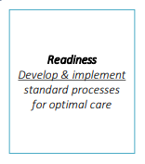
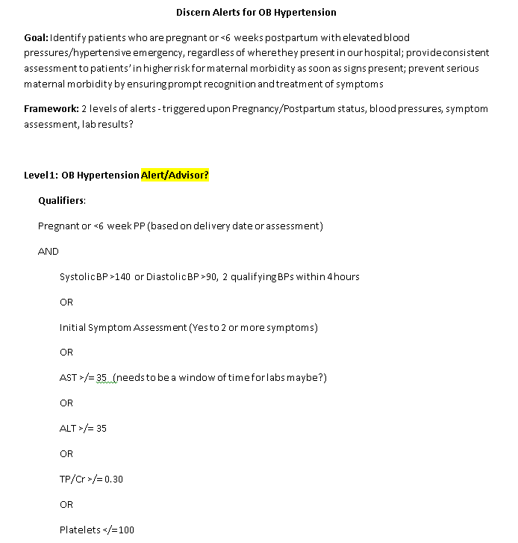
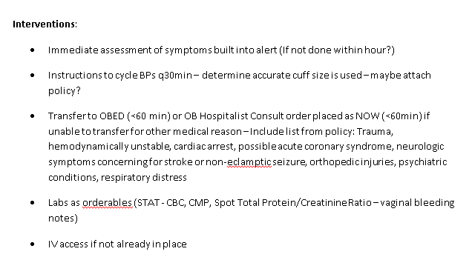
Discern Alerts for OB Hypertension

Slide 22
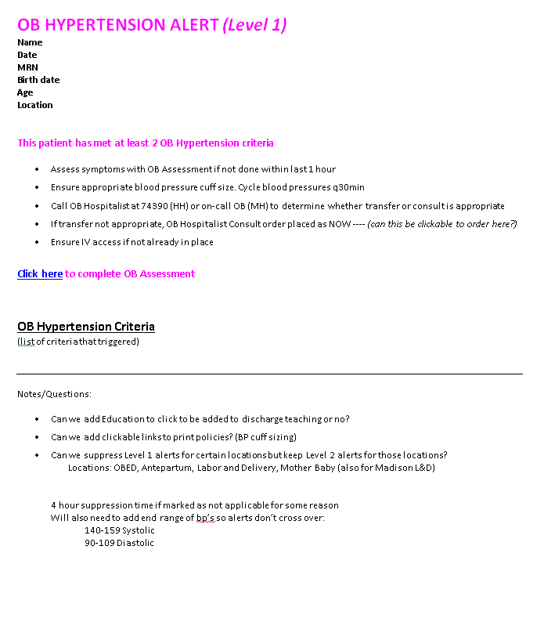

Slide 23
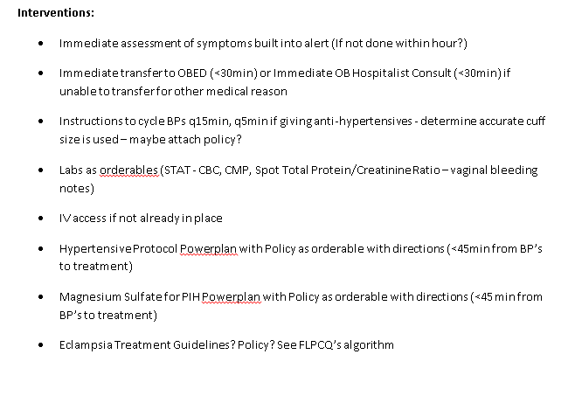

Slide 24
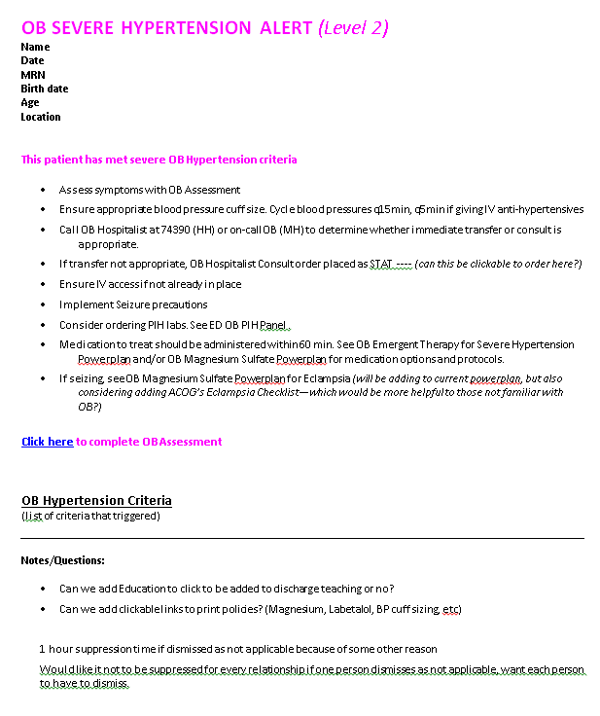

Slide 25
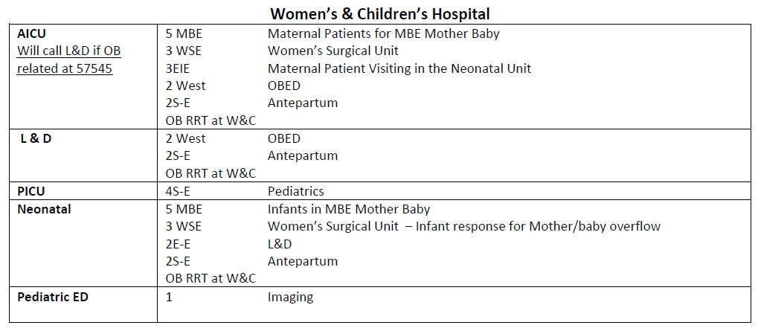
Rapid Response Updates

Slide 26
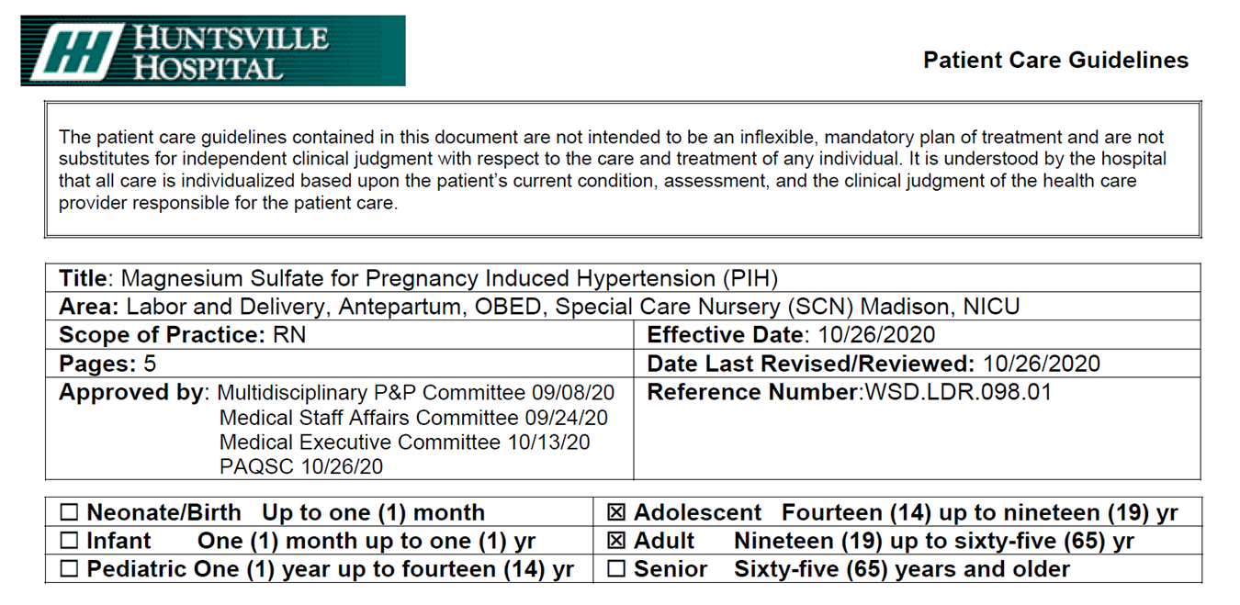

Slide 27
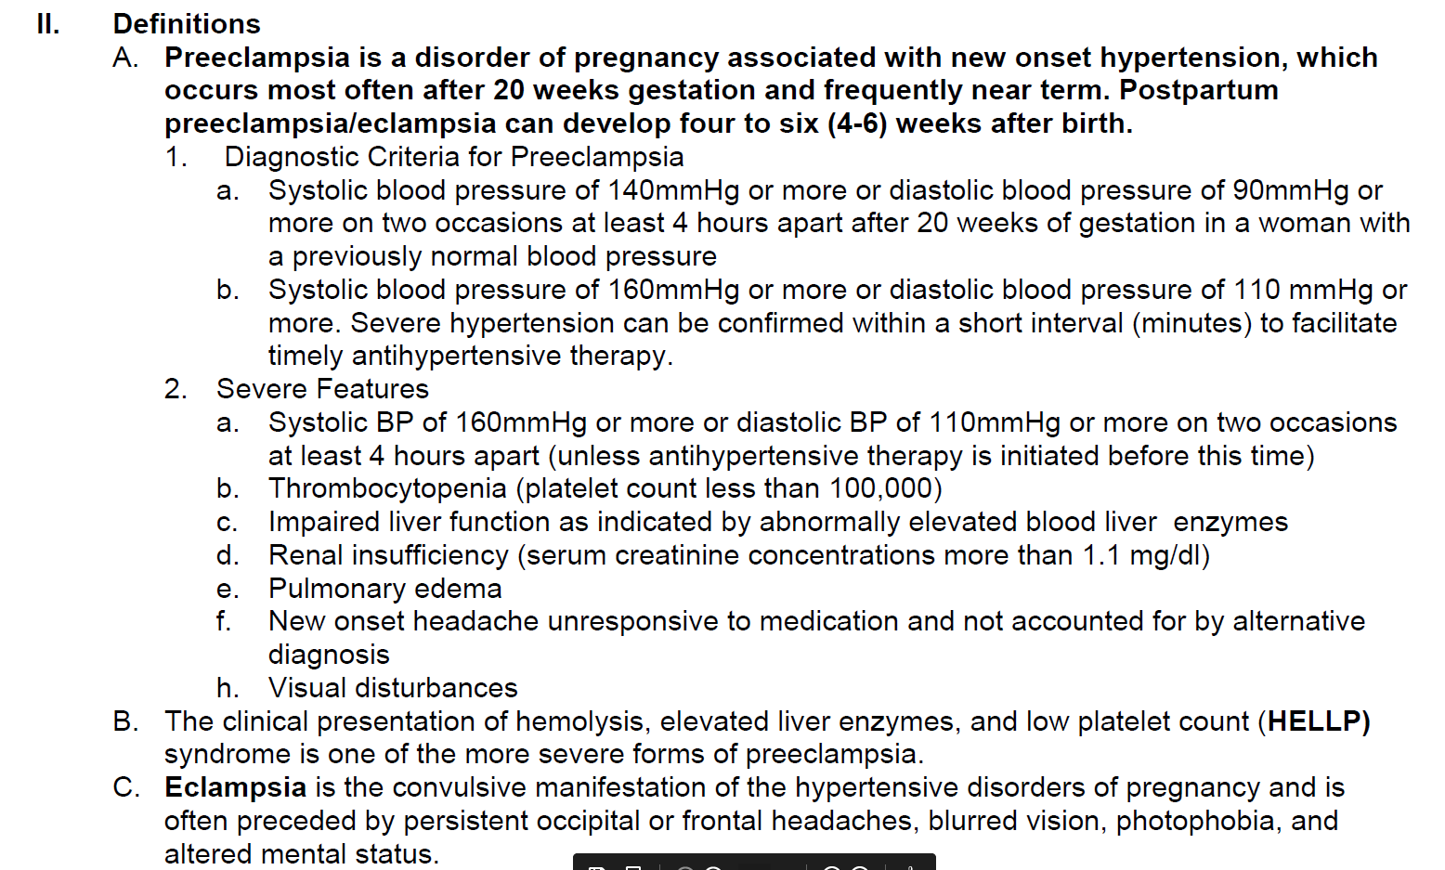

Slide 28
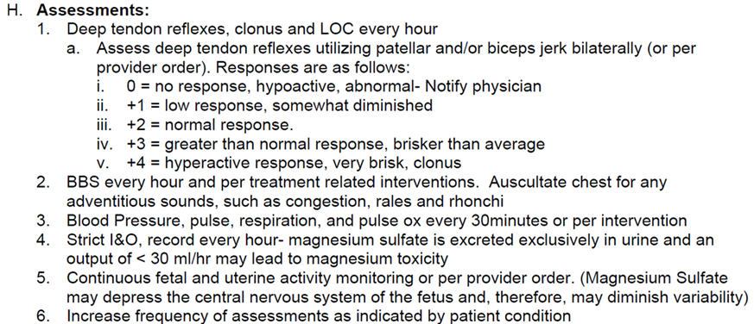

Slide 29
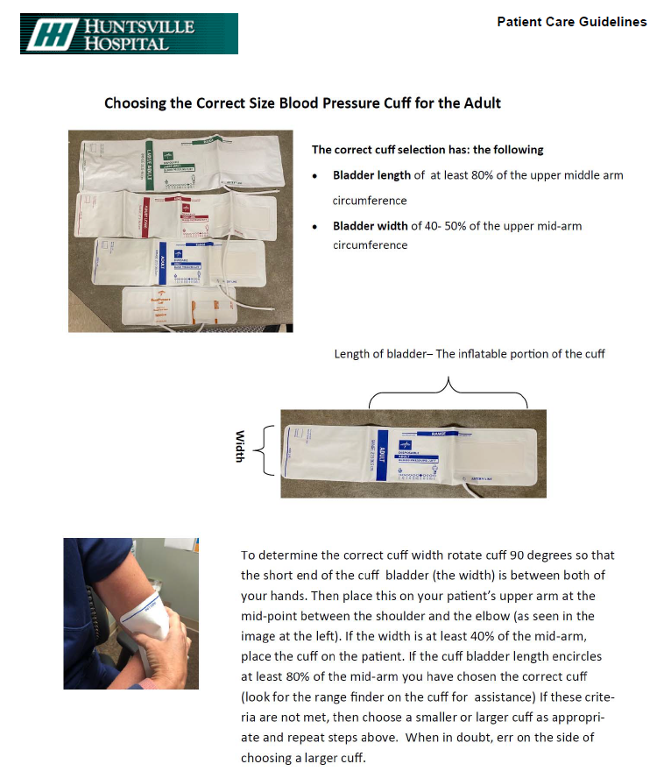
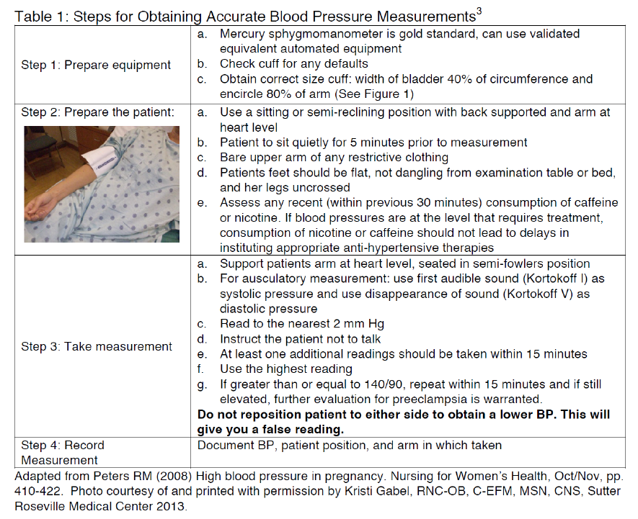
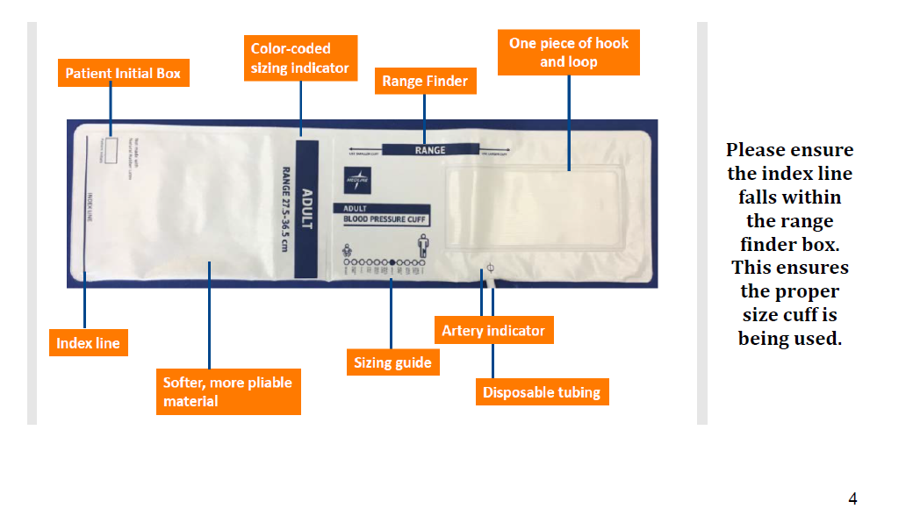

Slide 30
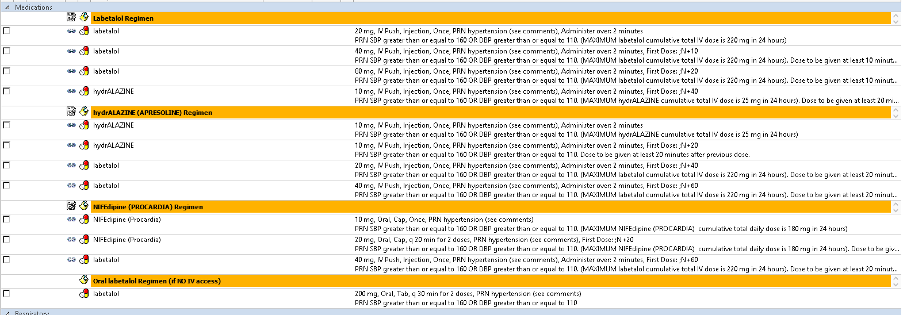
→
→

Slide 31
Challenges along the way…
→

Slide 32
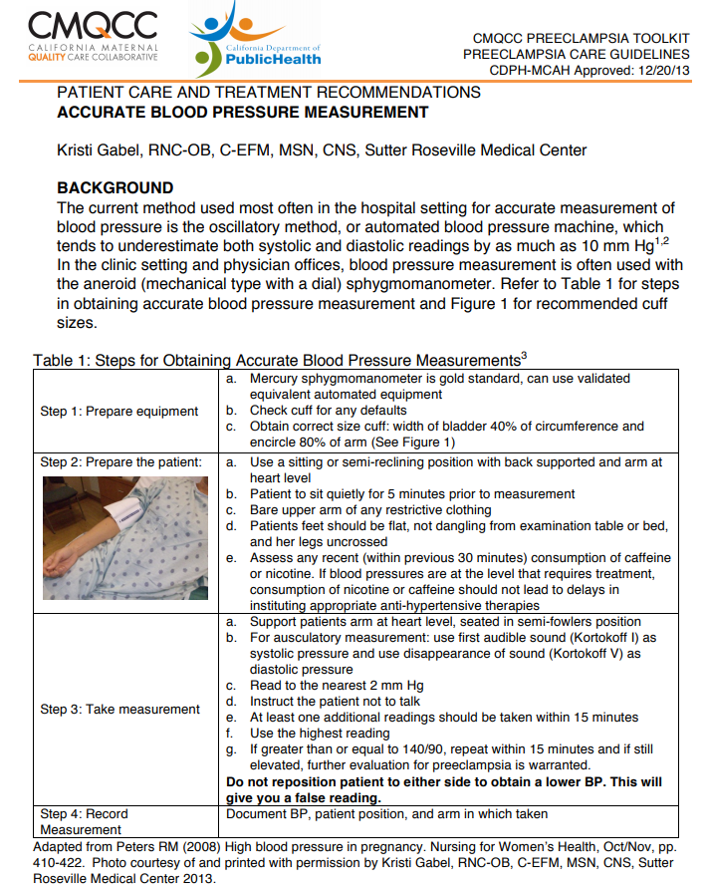
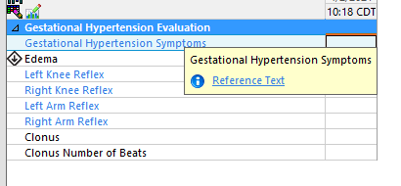

Slide 33
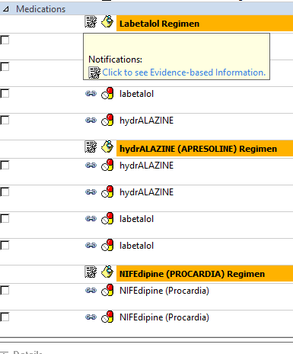
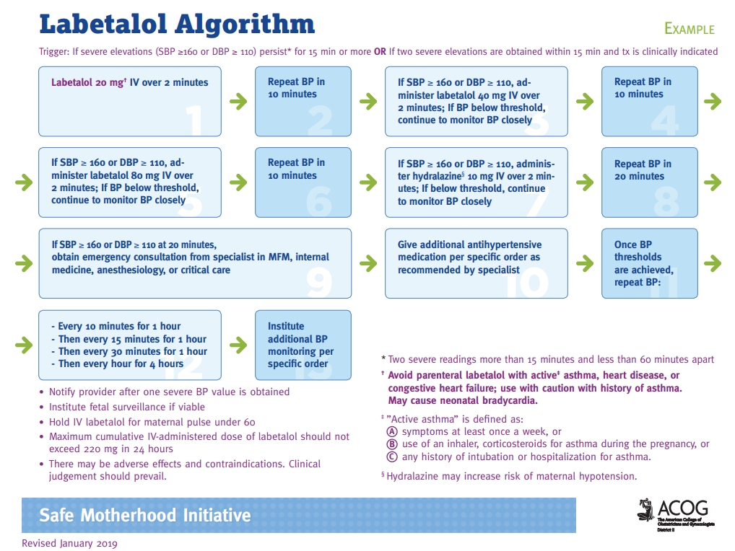

Slide 34
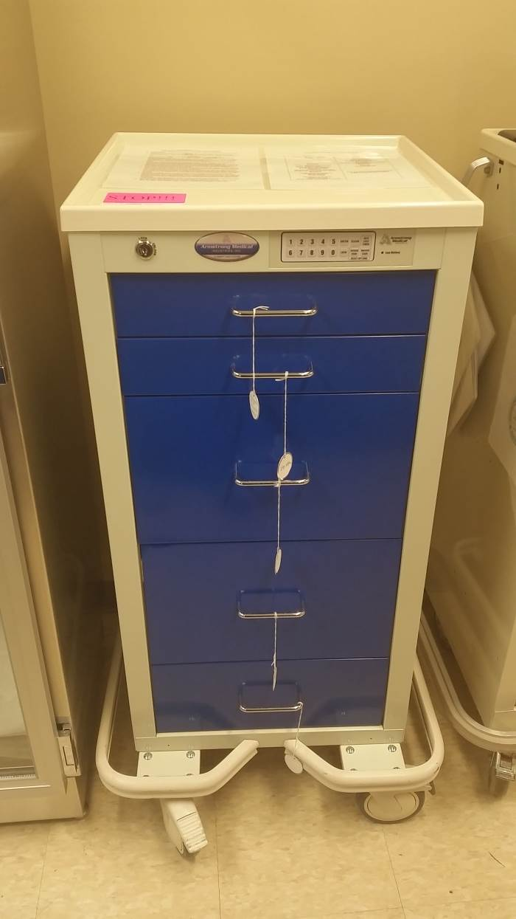
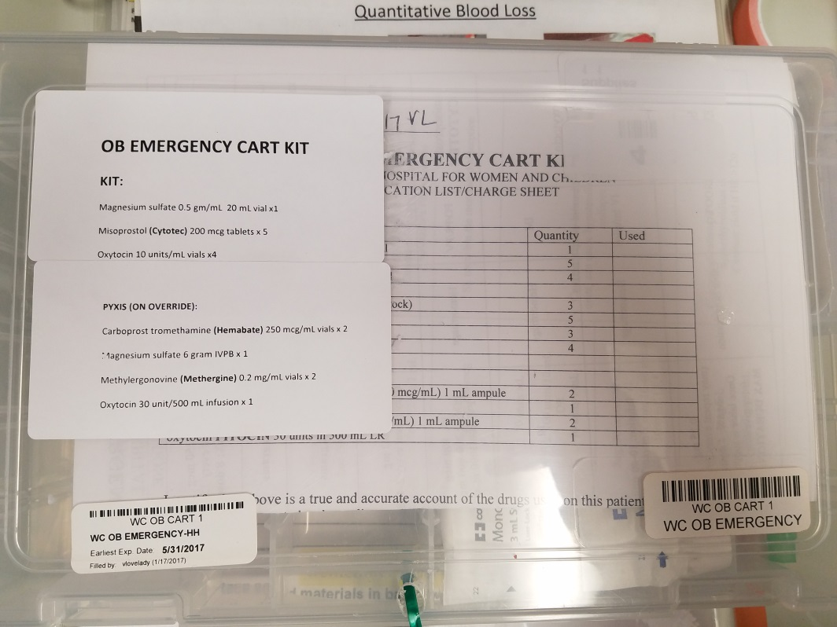
OB Emergency Cart

Slide 35
OB Emergency Cart

Slide 36
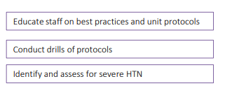

Slide 37
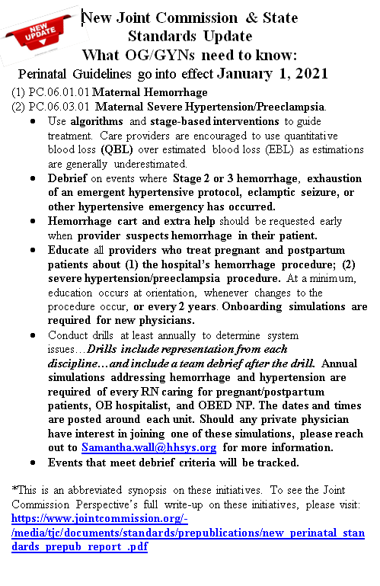
Staff Education:
Upon hire
Monthly Eclampsia simulations offered (1 required per calendar year)
Live classes for main emergency department
Computer Based Learning tests- tailored per department (Main ED, Anesthesia, Ped’s ED)- affiliate hospitals
Provider Education:
Upon credentialing
Welcome to monthly simulations
Education mailed yearly

Slide 41
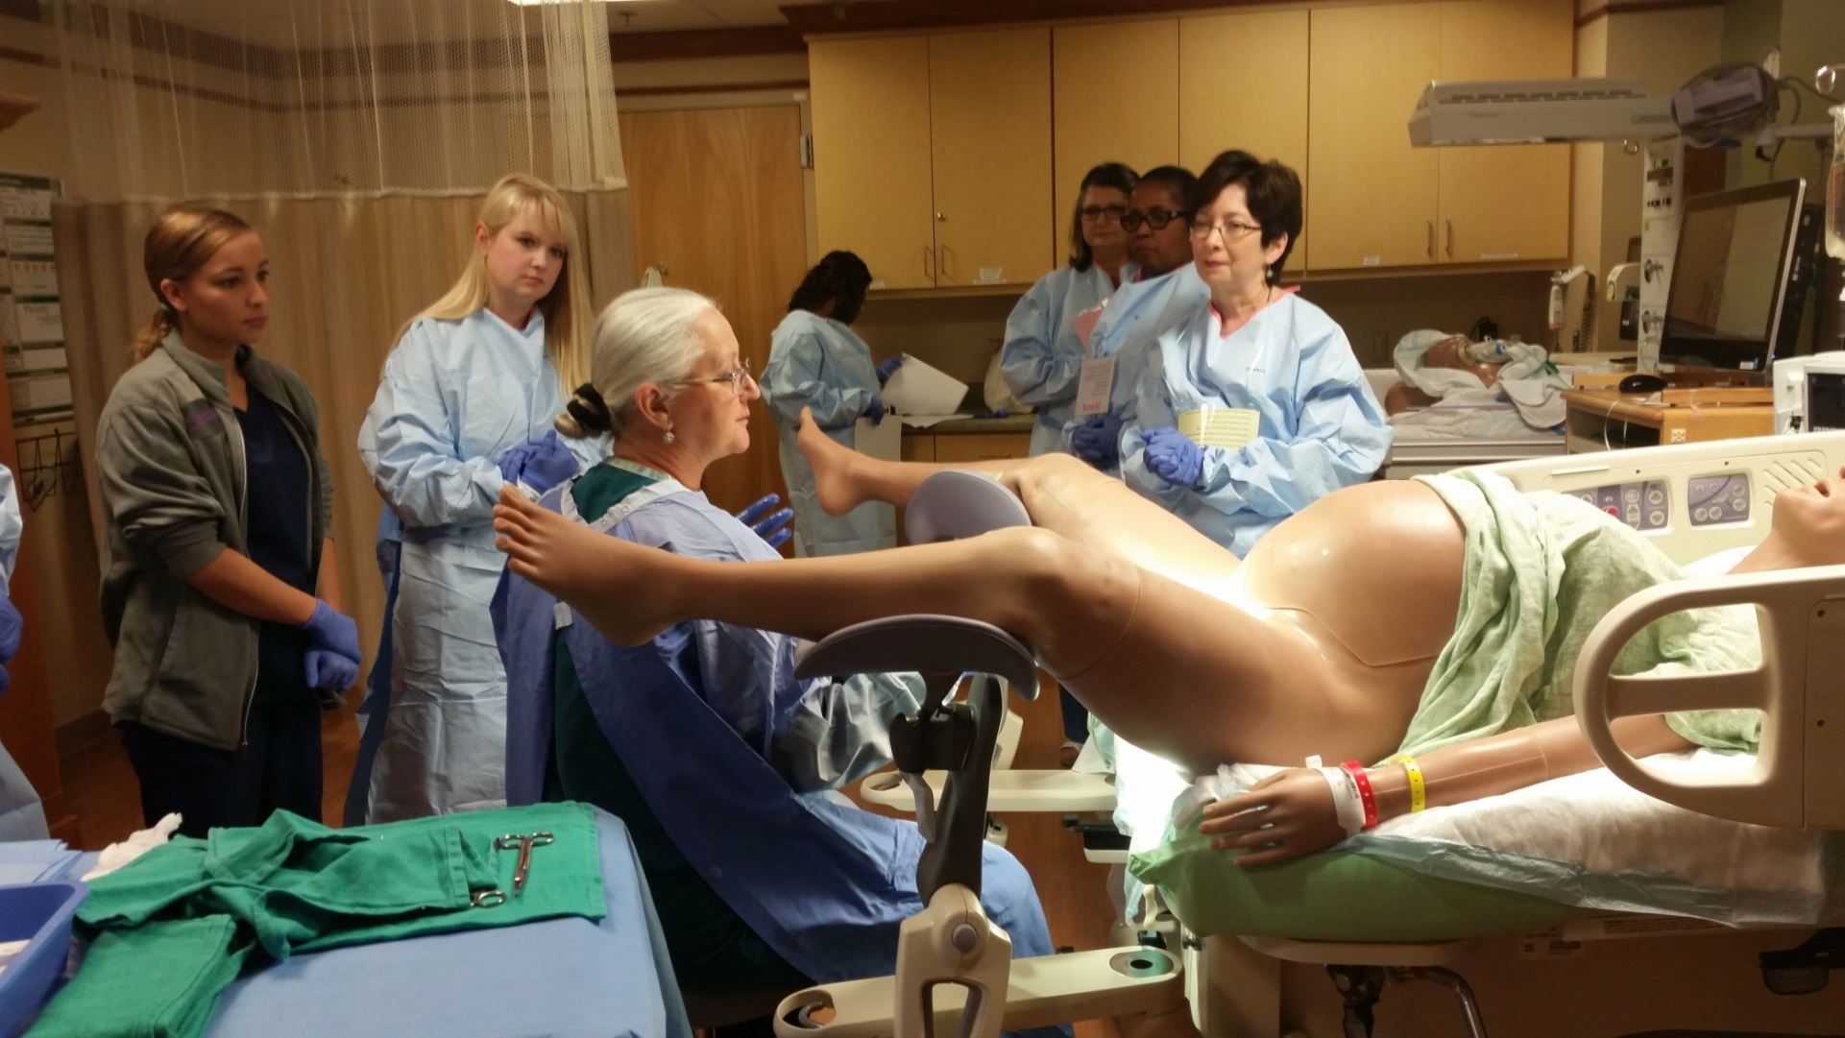

Slide 42
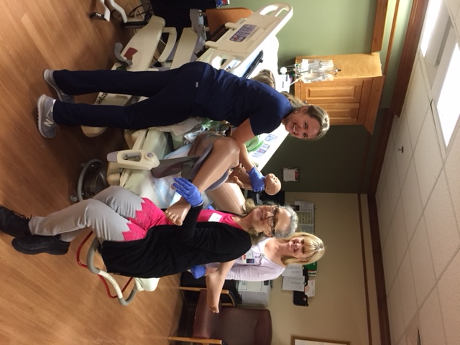
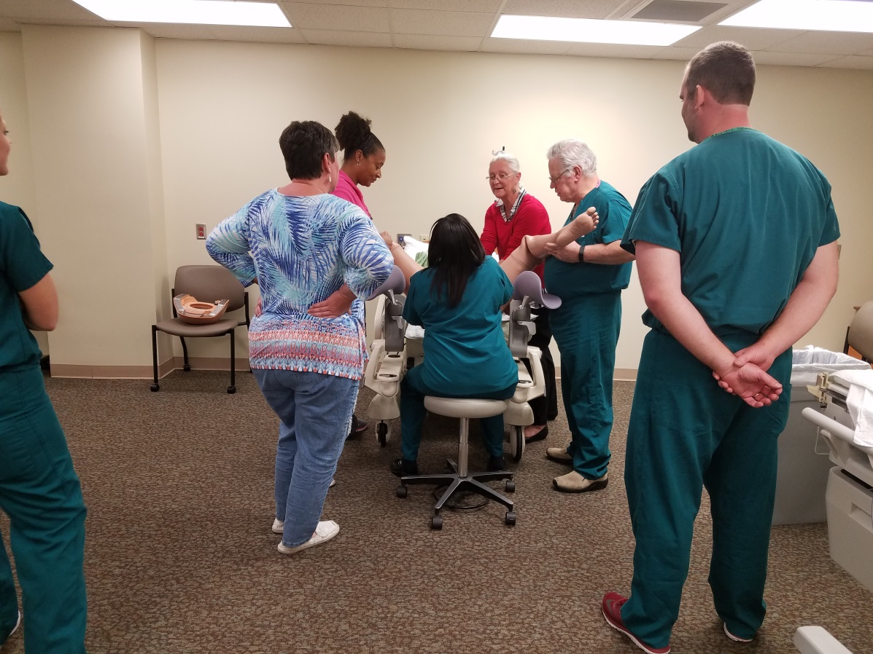

Slide 43
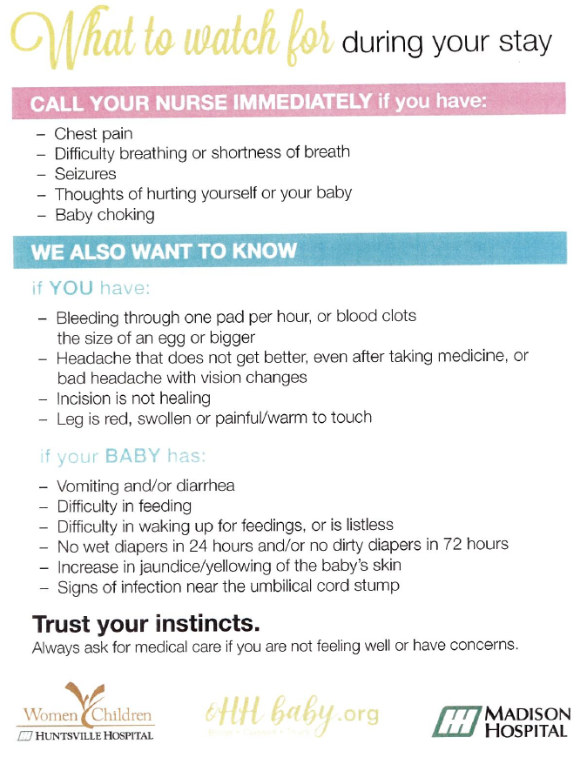
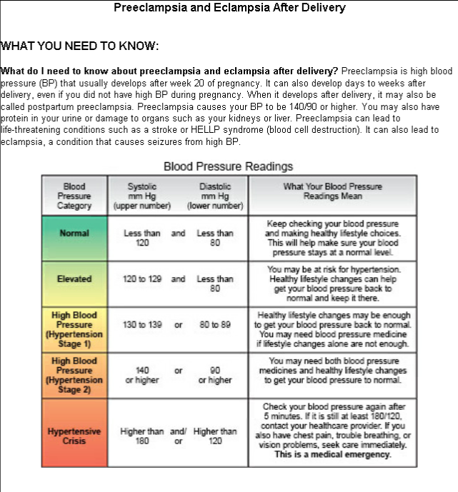

Slide 44
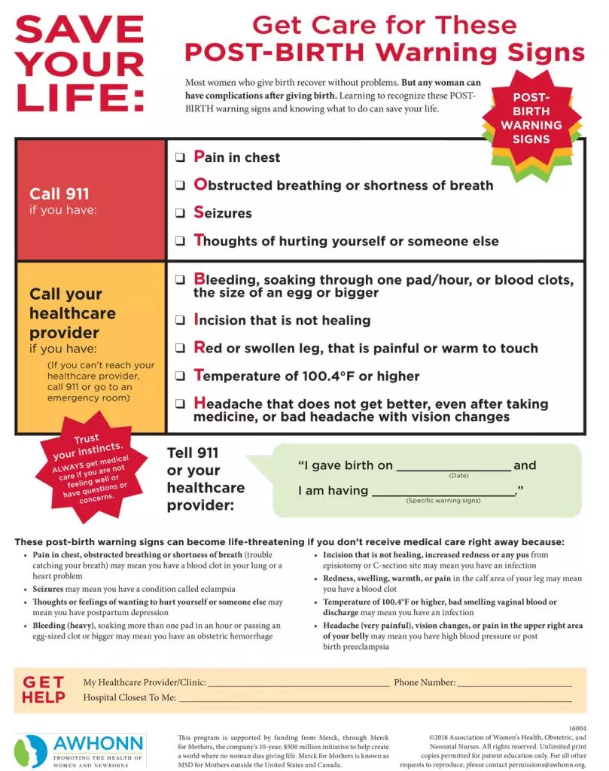

Slide 45
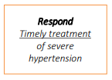
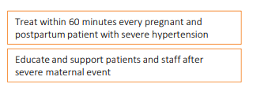

Slide 46
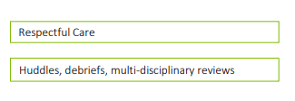

Slide 47
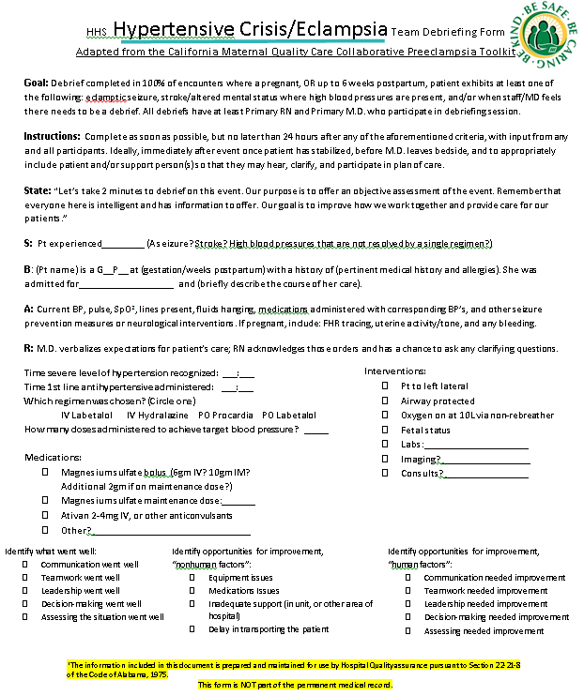
Safety Huddles: 0645? 0730?

Slide 48
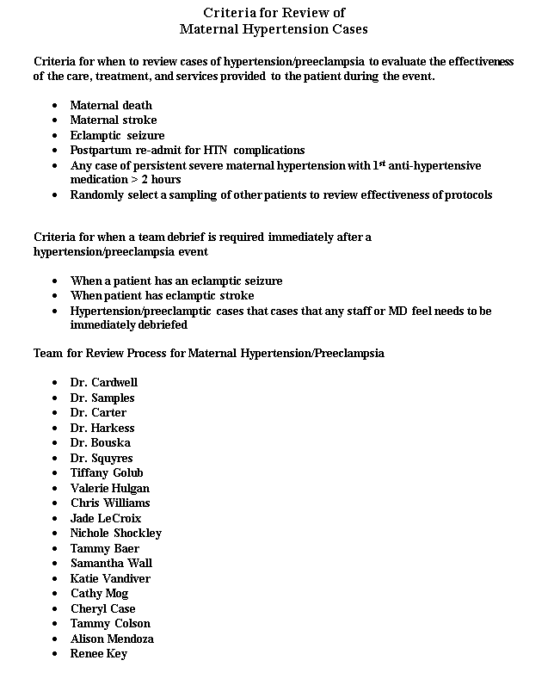

Slide 49
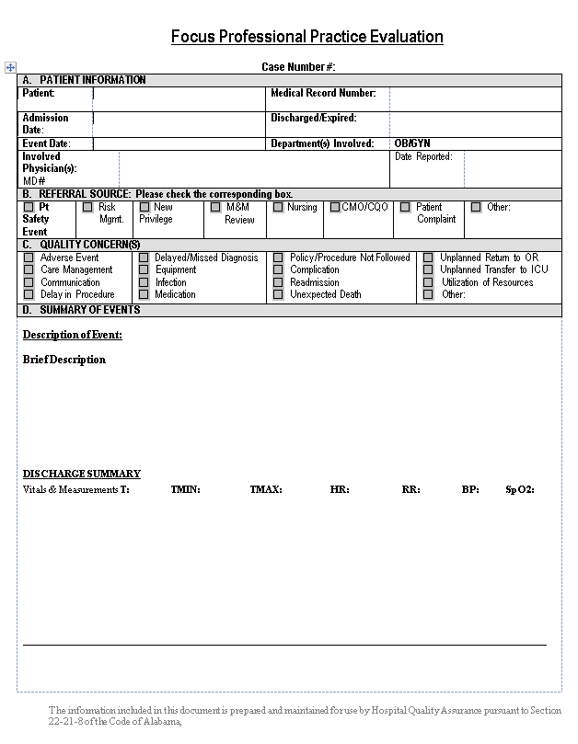
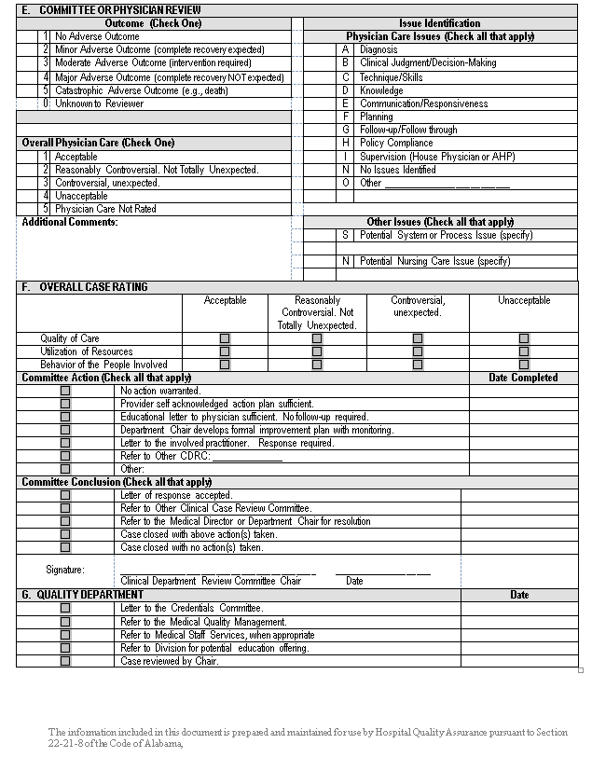

Slide 52
Q&A
Please feel free to unmute and ask questions
You may also enter comments or questions in the ”chat” box

Slide 53
Next Steps
Monthly (April) data due May 31
Remember monthly-self-assessment
If have not done so already, please also submit:
Baseline data
March monthly data
Quarterly data
Structural – once per initiative

Slide 54
Measure Type | Measure | Reporting Frequency
Process | P4. Provider education - % who completed education | Quarterly Due a month after quarter ends Jan-March 2021 quarter due April 30
 | P5. Nursing education - % who completed education | Once per initiative
 | P6. Unit drills - # of OB drills, topics
Measure Type | Measure | Reporting Frequency
Structural | S1. Severe HTN/Preeclampsia policies and procedures for pregnant and postpartum patients | Once per initiative yes/no/ in progress
 | S2. Debriefs | Once per initiative
 | S3. Multi-disciplinary case review protocols
 | S4. Patient/Family/Staff Support Resources and Protocols
 | S5. Severe HTN/Preeclampsia bundle processes (i.e. order sets, tracking tools) integration into hospital’s EHR system
Quarterly Process Measures and
Structural Measures
Find data forms, including ICD-10 codes, and baseline data collection instructions on our website at www.alpqc.org/initiatives/htn/, under the “Data Resources” menu​​

Slide 55
Next Steps
Submit data use agreement to csnowden@alaha.org
Meet with your team every month to review your data and plan next steps for your hospital implementation
Continue running PDSAs!
Samples and template on our website under “Key Documents”

Slide 56
Thank You
Next Call: Friday, June 25 at 12:00 PM

