Slide 1
Maternal
Initiatives
Action Period Call
January 17th, 2024
1:00 – 2:00 PM CT

Slide 2
Welcome
Please type your name and the organization you represent in the chat box and send to "Everyone"
Please click on the three dots in the upper right corner of your Zoom image, click "Rename" and put your name and organization.
Please also do for all those in the room with you viewing the webinar.
Attendees are automatically muted to reduce background noise.
You may enter questions/comments in the "chat" box during the presentation. We will have a Q&A session at the end.
Slides will be available via email and at http://www.alpqc.org/initiatives/htn
We will be recording this call to share, along with any slides.
Notes:
Thank you for joining us for today’s action period call. Please put your name and organization into the chat box. Please click on the three dots in the upper corner of your picture, click Rename, and include your name and put your name and organization. Below you can see buttons to mute, use the chat box, Please put questions in the chat box, we will address them at the end of the presentation.

Slide 3
Agenda
Activity | Time
1:00 – 1:10 | Welcome, Updates, and Reminders
1:10 – 1:20 | Breakout Groups - Introductions
1:20 – 1:30 | Severe Maternal Hypertension – Initiative Outcomes/Collaborative Performance
1:30 – 1:45 | Obstetric Hemorrhage Kickoff
1:45 – 1:50 | Q&A
1:50 – 2:00 | Severe Maternal HTN Sustainability

Slide 4
Updates
Obstetric Hemorrhage (OBH) Initiative enrollment is still open. Visit alpqc.org to register your team
OBH Baseline Reporting (Oct-Dec 2023) due January 31, 2024
Severe Maternal HTN Initiative Sustainability reporting (Oct-Dec 2023) due January 31, 2024
Quarterly ALPQC Newsletter (December 2023) available on alpc.org

Slide 5
Reminders
-Next OB Hemorrhage Action Period Call: Wednesday, 2/21 at 1 pm
-Neonatal Action Period Call is Wednesday, January 24th at 12 pm
-1-on-1 calls with ALPQC Quality Improvement RNs resumed this month. Please email info@alpqc.org if your facility has not yet scheduled your recurring meeting

Slide 6
Breakout Groups
If you are a physician, please stay in the main room
Everyone else, please select a breakout room
Approximately 5 members per group – please turn cameras on
10 minutes
Name, Title, Facility
Has your facility participated in previous ALPQC initiatives?
Obstetric Hemorrhage Initiative - general thoughts, potential challenges, needed resources

Slide 7
Severe Maternal HTN
Initiative Outcomes/Collaborative Performance

Slide 8
Initiative Outcomes
Discharge education increased from 58% to 91% regarding signs and symptoms of preeclampsia/eclampsia complications for patients who experienced severe hypertension during their birthing admission
Follow-up appointments within 7 days increased from 56% to 76% for these still at-risk patients
Evidence-based treatment protocols for severe maternal hypertension were implemented or revised to standardize interventions for L&D and postpartum patients

Slide 9
Collaborative Performance
22 hospitals participated
73% of participating hospitals reported >90% of monthly data
The collaborative was interrupted due to COVID-19, but hospitals persevered!
35 Hospitals were represented at the ALPQC Summit last September
Thanks to your hard work, participation in the initiative, and dedication to improving maternal outcomes in Alabama, the ALPQC received CDC funding through 2027 – THANK YOU!!!

Slide 10
Obstetric Hemorrhage
Kickoff

Slide 11
Where Do I Start?

Slide 12
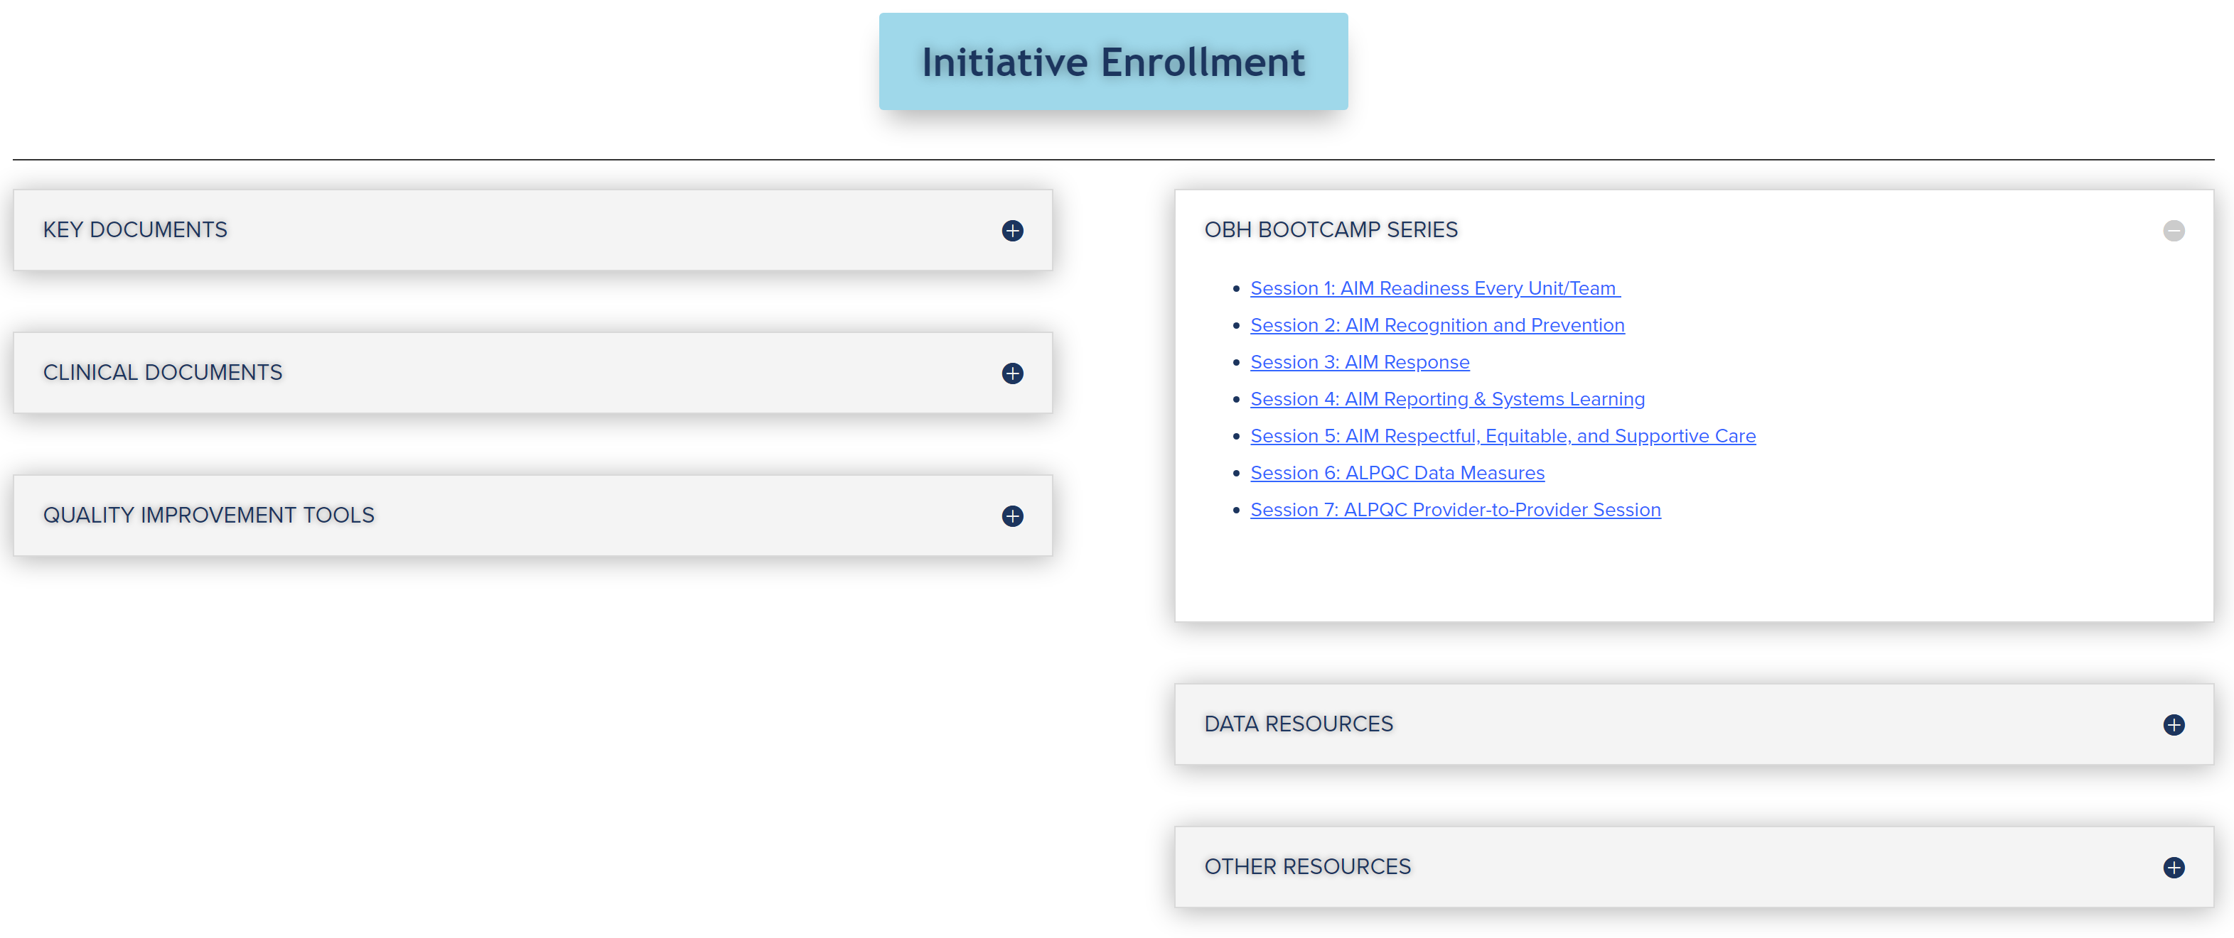
OBH Bootcamp Video Series
Readiness
Recognition and Prevention
Response
Reporting and Systems Learning
Respectful, Equitable, and Supportive Care
IT Support Zoom/Video
Provider-to-Provider Video

Slide 13
Clinical Documents

Slide 14
Data Resources

Slide 15
Baseline Data Reporting
Reporting Period: October – December 2023
Survey emailed on 1/5/24, Revised survey will be released this week
Due January 31st, 2024

Slide 16
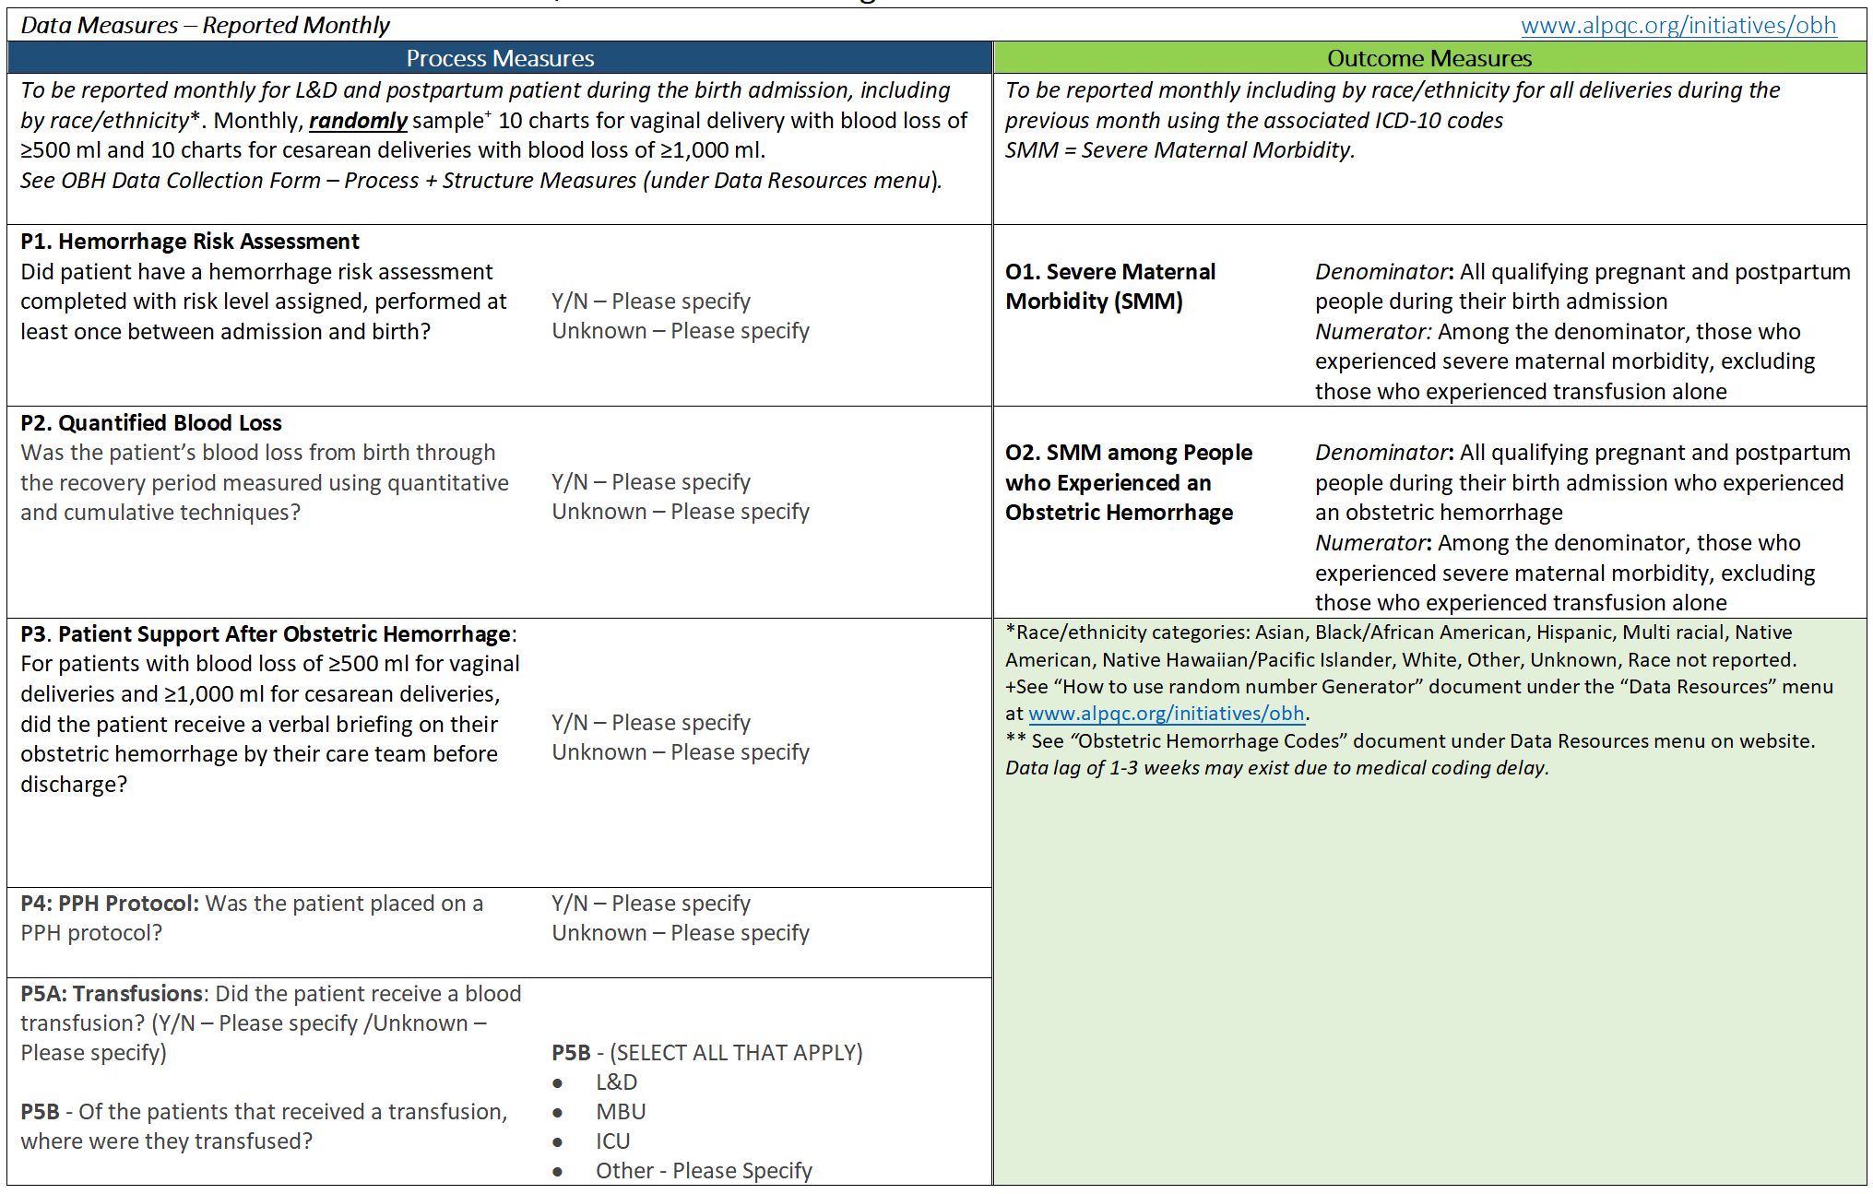
Monthly Data Reporting
Reporting Period: January 1-31, 2024
Survey will be emailed on 2/5/24
Due February 29th, 2024

Slide 17
Quarterly Data Reporting
Reporting Period: January-March, 2024
Survey will be emailed on 4/5/24
Due April 30th, 2024

Slide 18
Q&A
Please feel free to unmute and ask questions
You may also enter comments or questions in the "chat" box

Slide 19
Severe Maternal HTN
Sustainability

Slide 20
Sustainability Reporting
Reporting Period: October - December, 2023
Survey was emailed on 1/12/24
Due January 31st, 2024
If you did not receive an email with the link to the survey, please email info@alpqc.org

Slide 21
Sustainability Data
Monthly Data Measures Reported Quarterly
Measure Type | Measure​s | Measurement Period | Reporting Due*​
Outcome | 1. SMM (excluding transfusion codes)​ | Oct – Dec 2023 Jan – Mar 2024 Apr – Jun 2024 July - Sep 2024 Oct – Dec 2024 | Jan 31, 2024 April 30, 2024 Jul 31, 2024 Oct 31, 2024 Jan 31, 2025
Outcome | 2. SMM among people with preeclampsia (excluding transfusion codes)​
10 randomly selected charts per month (or less, depending on volume) | For pregnant and postpartum patients with persistent severe HTN during hospitalization: | Quarters: Jan 2020 – Feb 2021​ | ​
Process Patient-level | Timely treatment of persistent severe HTN: Pregnant & postpartum patients with acute-onset persistent severe hypertension treated within 60 minutes with IV Labetalol, IV Hydralazine, or PO Nifedipine
Process Patient-level | 2. Follow-up appointment: Patient discharged with a postpartum BP and symptoms check scheduled
Process Patient-level | 3. Discharge education: Patient and family education on preeclampsia signs & symptoms prior to discharge
All Measures Reported by Race/ Ethnicity
Find data forms, including ICD-10 codes, on our website at http://www.alpqc.org/initiatives/htn, under the “Data Resources” menu

Slide 22
Q&A
Please feel free to unmute and ask questions
You may also enter comments or questions in the "chat" box

Slide 23
Reminders
Neonatal Action Period Call is Wednesday, January 24th at 12 pm
- Next OB Hemorrhage Action Period Call: Wednesday, 2/21 at 1 pm
- 1-on-1 calls with the ALPQC Quality Improvement RNs resumed this month. Please email info@alpqc.org if your facility has not yet scheduled your recurring meeting

Slide 24
Stay Connected!
Online
https://www.alpqc.org
Email: info@alpqc.org
Twitter: @alpqc
https://twitter.com/alpqc
Notes:
https://docs.google.com/spreadsheets/d/1hWaB8J76ojbpNPMovDPop1SaYcNGBN7ld7Tj54DFh_k/edit#gid=0

